Slide 1
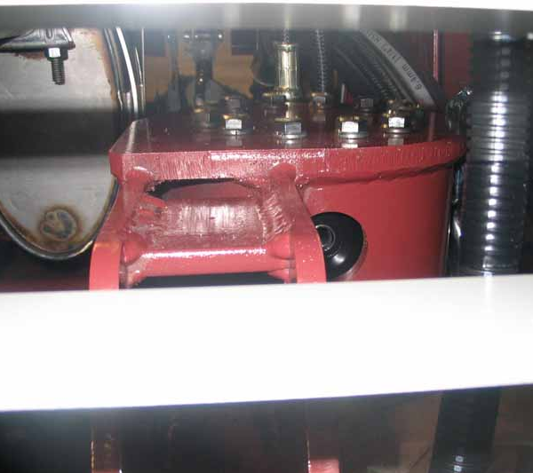
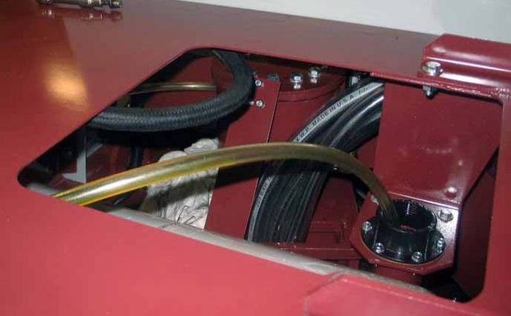
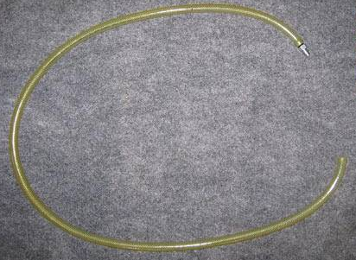
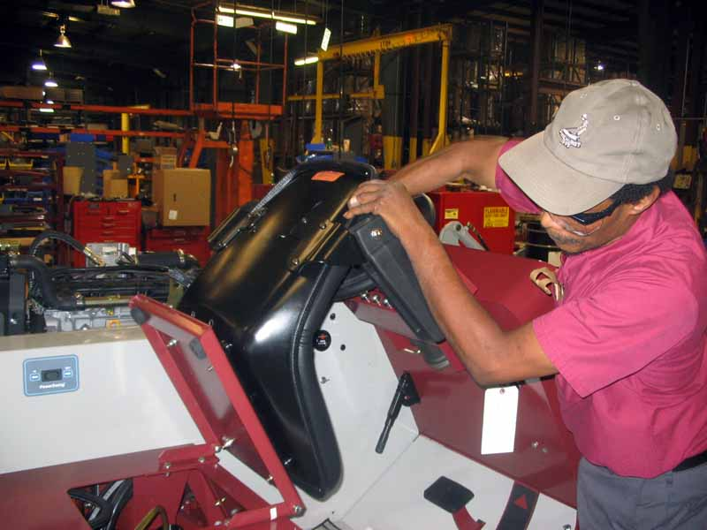
Quality Alert 092711- Helac “Bleed” Procedure
Date= 9/27/2011
Helac Steering Actuator “Bleed” Procedure
3. Remove the hydraulic reservoir fill cap, insert the end of the bleed hose
1. Located “Upper” Helac “Bleed Port”
4. Start the engine and place the engine in “High RPM” position.
2. Thread the “bleed hose/fitting Assembly” in to the “Upper” Helac “Bleed Port”
5. Turn the steering all the way to the left, then back to the right. Repeat this step until no air is visible in the “Bleed Hose”
Repeat steps 1-5 for “Lower” Helac “Bleed Port”
Note: Using paint marker, mark the letter “B” (Bleed) and your initials on the Helac mount
{QA 092711}

